Slide 1

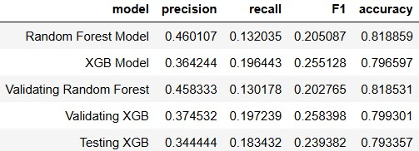
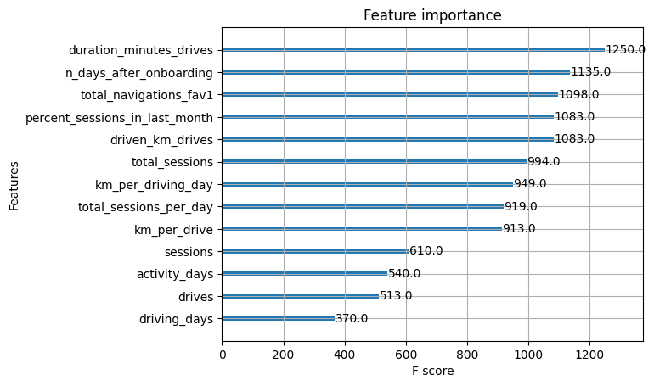
User Churn Project | ML Model Results
Prepared for: Waze Leadership Team
The Waze data team is tasked to develop a Machine Learning (ML) model for churn rate prediction. This is part of a larger growth program in the company, by analyzing churns and maximizing user retentions.
The project’s goal is to provide predictive analysis as well as identifying key factor and insights that are most affecting churns.
To develop a ML model with highest predictive performance, the Waze data team decided to build and compare two learners: Random Forest model vs. XGBoost model.
The data was splitted into three categories: Training set, Validation set, and Test set. So-called models were fit and trained by Training set (each using cross-validation within training set). Then their result scores were compared based on Validation set, and hence the champion model was selected: XGBoost. In order to assess the ultimate performance of the champion model, it was tested against the held-out Test set.
ML Models suggest a need for additional in order to enhance the model accuracy and efficiency.
The analysis also suggests that more features in the data needs to be collected. For instance, features such as `driver’s job`, `time of drive`, `road type`, `drive type`, `drive location`, etc. may provide better insights on those who are more likely to churn.
Feature engineering (extraction of new features out of existing raw features) turned to be pretty meaningful in the prediction of churn. Hence more features and more feature engineering may be suggested for another round of model construction
Engineered features accounted for six of the top 10 features: km_per_hour, percent_sessions_in_last_month, total_sessions_per_day, percent_of_drives_to_favorite, km_per_drive, km_per_driving_day.
Both model’s recall score are significantly better than previous logistic regression results. “Random tree” based models provide much better performance, however they cannot bold the importance of key features as well

